Slide 1
Impact of Emerging Technologies on Everyday Life
Exploring AI, AR, and VR
Exploring AI, AR, and VR
Exploring AI, AR, and VR

Slide 2
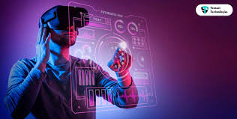
Introduction
Overview: Emerging technologies are transforming daily life, influencing how we work, learn, shop, and interact.
Focus Areas: Artificial Intelligence (AI), Augmented Reality (AR), and Virtual Reality (VR).

Slide 3
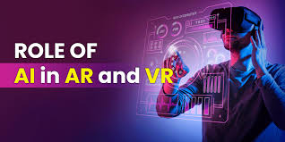
Artificial Intelligence (AI) in Daily Life
Definition: AI enables machines to mimic human intelligence.
Applications:
  Smart Assistants: Devices like Siri and Alexa assist with daily tasks.
  Recommendation Systems: Platforms like Netflix and Amazon suggest content based on user behavior.
  Healthcare: AI aids in diagnostics and personalized treatment plans.

Slide 4
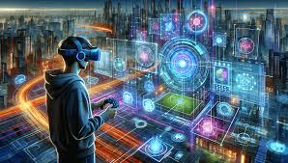
Augmented Reality (AR) Enhancing Experiences
Definition: AR overlays digital information onto the real world.
Applications:
  Retail: Apps like IKEA Place allow users to visualize furniture in their homes.
  Education: AR enhances interactive learning experiences.
  Navigation: AR provides real-time directions and information

Slide 5
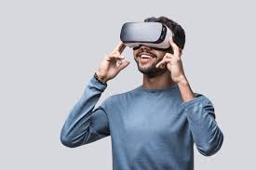
Virtual Reality (VR) Immersing Users
Definition: VR creates a simulated environment for users to interact with.
Applications:
  Gaming: Games like Beat Saber offer immersive experiences.
  Training: VR is used for simulations in fields like aviation and medicine.
  Entertainment: Virtual concerts and events provide new forms of engagement.

Slide 6
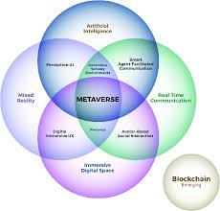
Convergence of AI, AR, and VR
Integration: Combining AI, AR, and VR creates more intelligent and immersive experiences.
Examples:
  Smart Glasses: Devices that provide AR overlays with AI-driven functionalities.
  Virtual Assistants: AI-powered assistants in VR environments.
  Enhanced Training: Simulations that adapt in real-time to user actions.

Slide 7
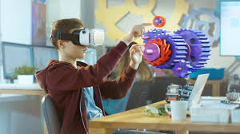
Impact on Education
Personalized Learning: AI tailors educational content to individual needs.
Interactive Lessons: AR brings subjects like history and science to life.
Immersive Training: VR provides hands-on experience in a controlled environment.

Slide 8
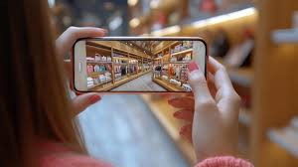
Transforming Retail and Shopping
Virtual Try-Ons: AR allows customers to try products virtually.
AI Recommendations: Personalized shopping experiences based on user preferences.
Efficient Checkout: AI-powered systems streamline the purchasing process.

Slide 9
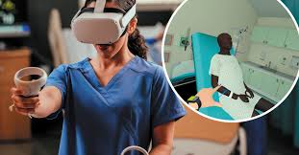
Enhancing Healthcare
Diagnostics: AI assists in analyzing medical data for accurate diagnosis.
Surgical Training: VR simulations provide practice for complex procedures.
Patient Monitoring: AI tracks patient health metrics for timely interventions.

Slide 10
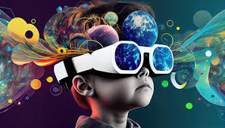
Future Outlook
Advancements: Continued development in AI, AR, and VR technologies.
Integration: Seamless merging of these technologies into daily life.
Ethical Considerations: Addressing privacy, security, and accessibility issues.

Slide 11
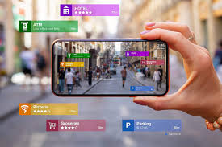
Conclusion
Summary: AI, AR, and VR are revolutionizing everyday experiences.
Impact: These technologies enhance convenience, learning, and engagement.
Call to Action: Stay informed and adapt to these technological advancements.

Slide 12

Questions & Discussion
Prompt: Open the floor for questions and further discussion.

Slide 13
Work
Question 1:Explain two ways in which Artificial Intelligence (AI) has impacted everyday life. Provide examples in your answer.
Question 2:Describe the difference between Augmented Reality (AR) and Virtual Reality (VR), and give one real-world example of each being used in daily life.

